Slide 1

Real Estate Sales in Perth 2010 to 2020
Analysis completed by
Athira Reji, Zonia Quiroga & Aaron Bilbow

Slide 2
Project Overview
The project aims to analyse the housing price trends in Perth, Australia. Identify areas of high and low property values. Identify key factors in the suburb sale price. Understand whether factors including location, floor area, number of bedrooms, number of bathrooms, proximity to schools or transport infrastructure/development and other amenities have any influence on the housing prices. The research will reveal the relative significance of different attributes and their combined impact on property values
Database Used
All data being used is from the CSV data generated from:
Kaggle
We have only used data from 2010 to 2020

Slide 3
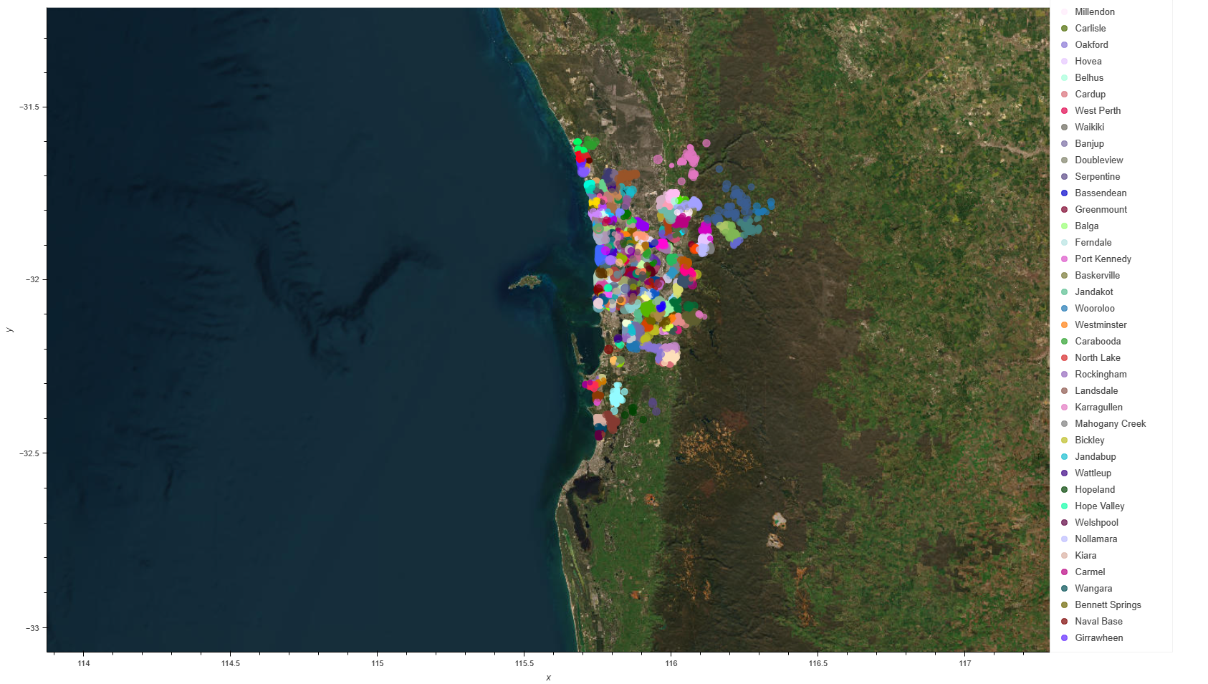
Total Sales within the study area in Perth region from 2010 to 2020

Slide 4
Does location characteristics and property characteristics impact housing prices in Perth, Australia?
Does the cost of homes in Perth depend on its proximity to the central business district?
Are house costs and the quality of the neighbourhood schools correlated? Examine if homes that are close to schools tend to sell for more money?
Does the cost of homes in Perth depend on its closeness to public transit (such as railway stations and bus stops)? Investigate if houses close to points of public transportation tend to be more expensive than those further away?
Does house characteristics including land area, floor area, number of bedrooms, number of bathrooms, have any influence on the housing prices?

Slide 5
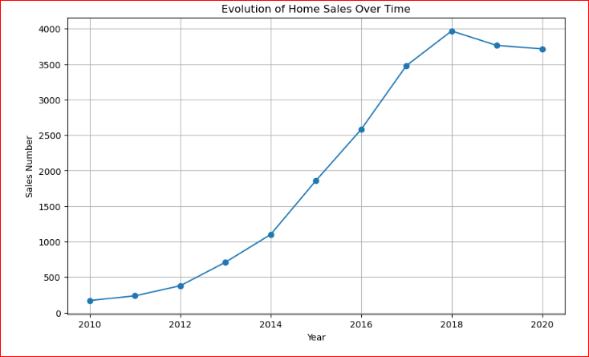
This graph represent the total houses sales per year, this is showing that the houses sold per year has steadily increased even during the time of the largest commodity price fall during 2014 and 2015

Slide 6
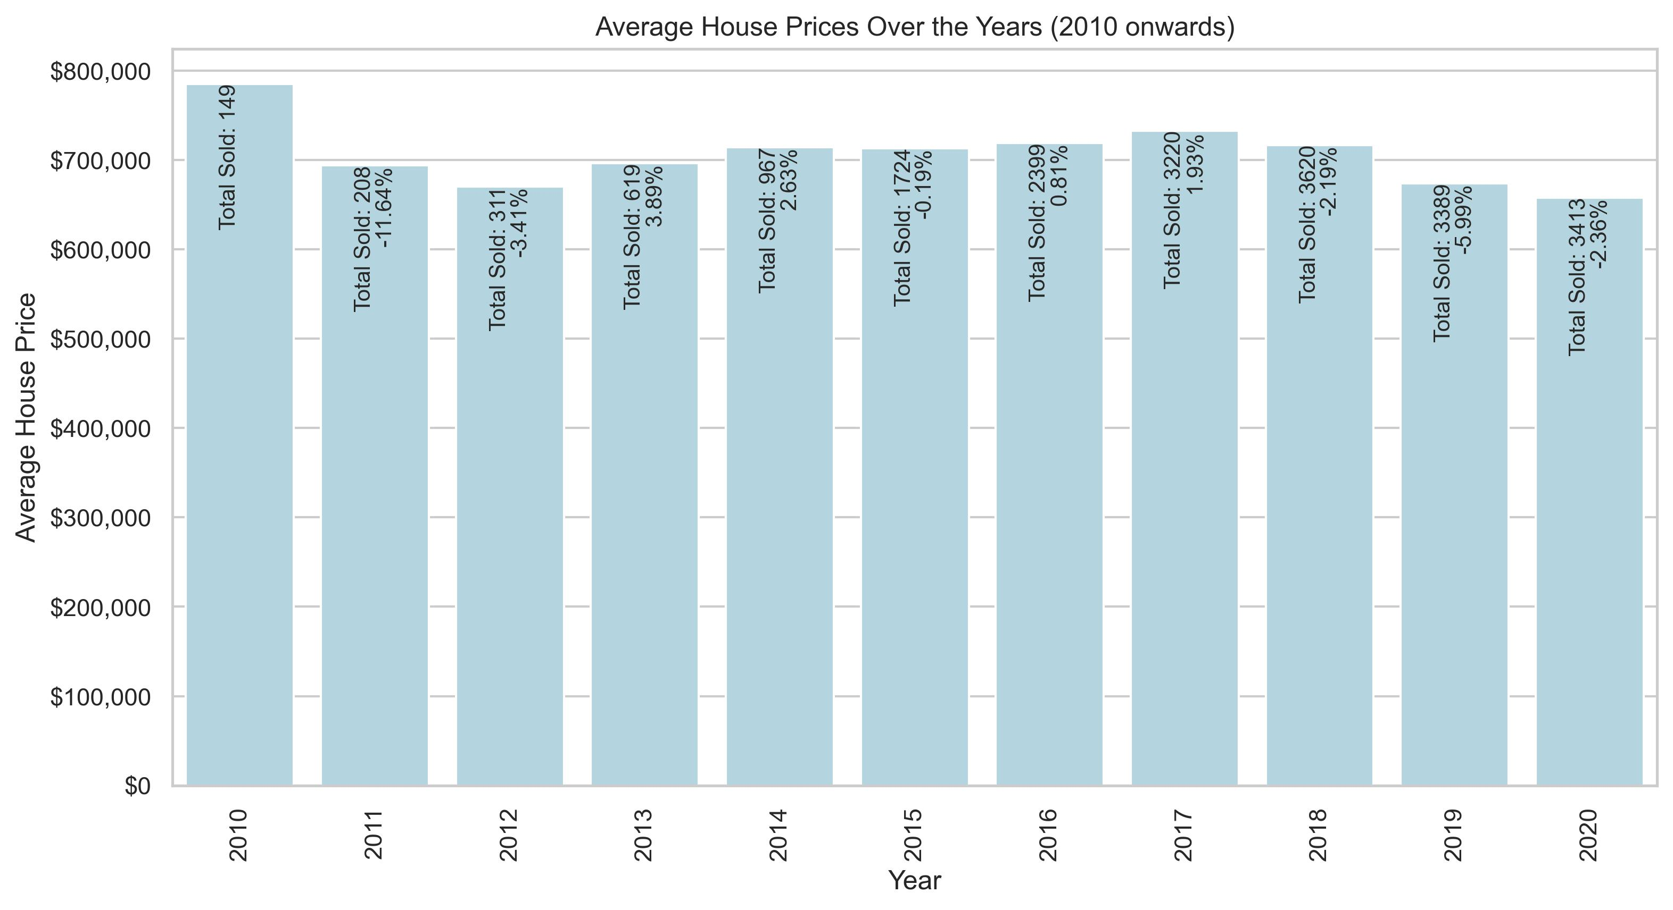
This graph represents the total sold properties during the years listed showing also the percentage variance in total sales compared to the previous year.

Slide 7
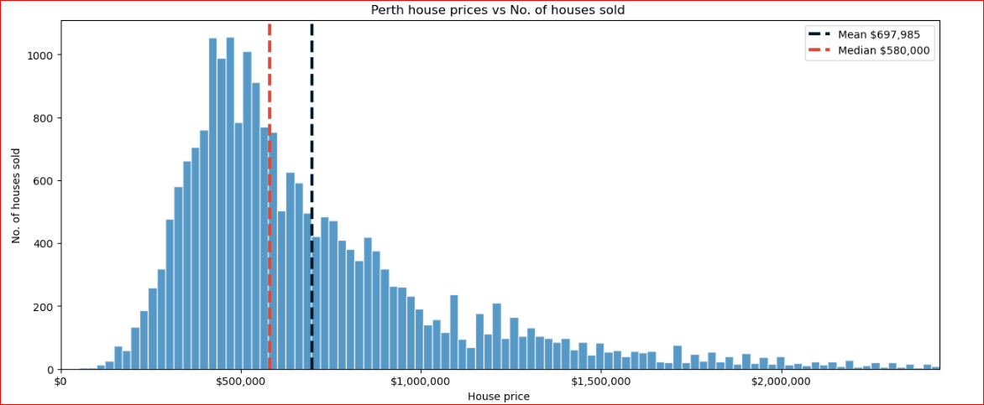

Slide 8
Proximity to CBD
Proximity to Train Station
Proximity to Schools
Does location characteristics impact housing prices in Perth?

Slide 9
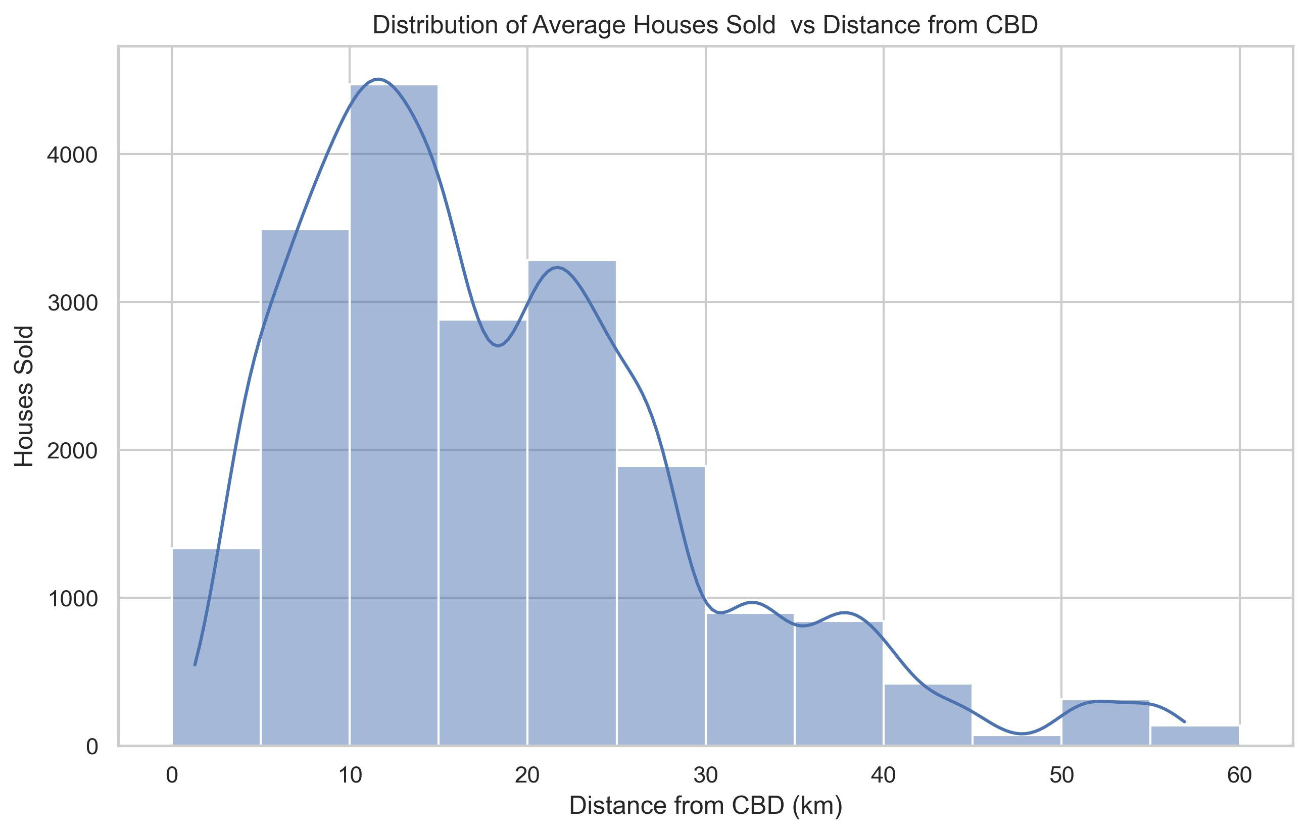

Slide 10
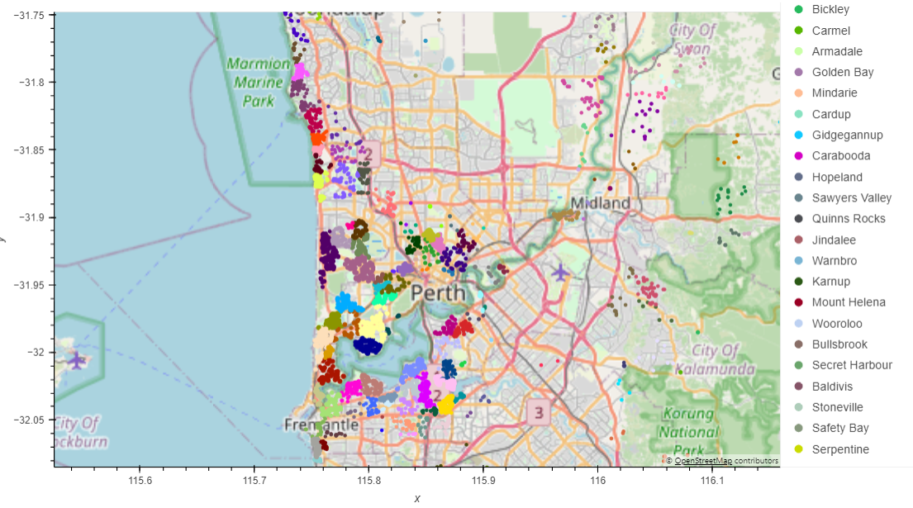
The map illustrates the spatial arrangement and positioning of the most expensive residences, constituting the top 20% in value across the entire region.

Slide 11
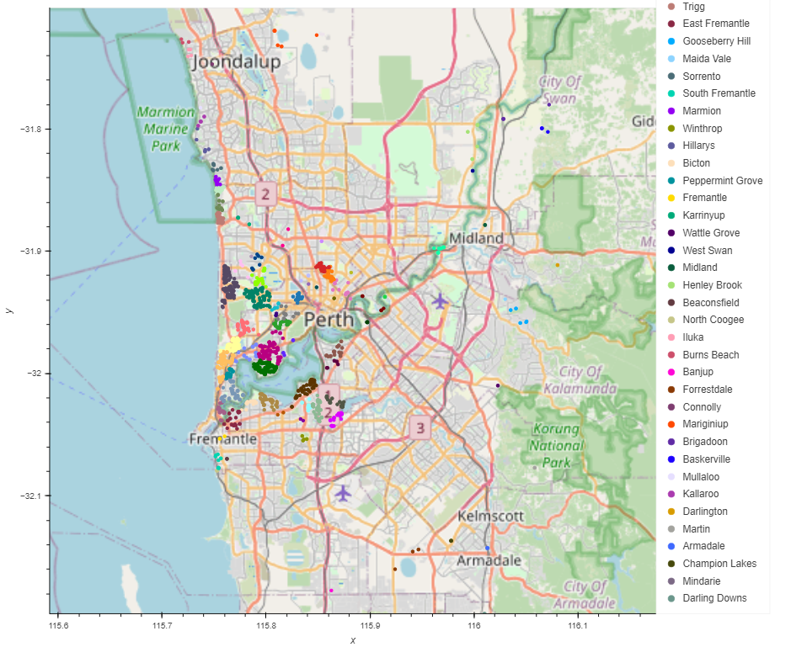
The map illustrates the spatial arrangement and positioning of the most expensive residences, constituting the top 5% in value across the entire region.

Slide 12
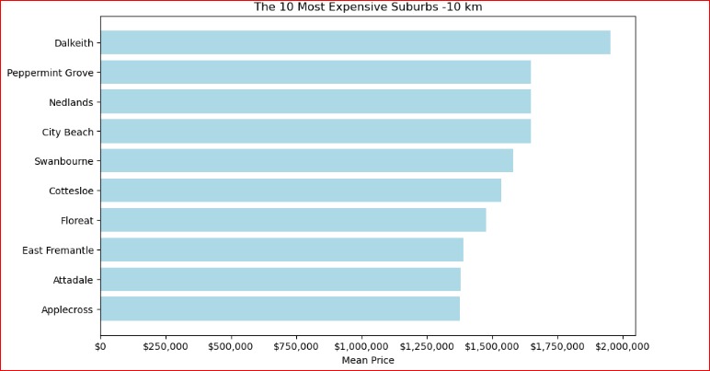
This graph represents the most expensive sales prices in the 10km region from the city centre, this is just based off total sales figures not taking into account bedrooms or bathrooms

Slide 13
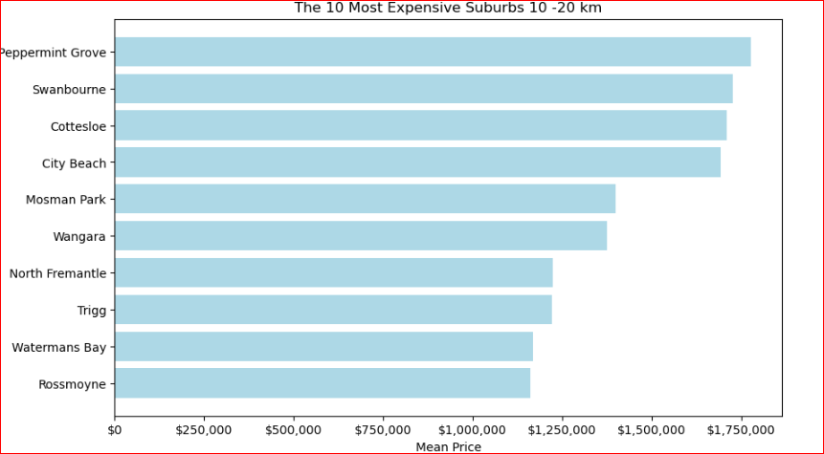
This graph represents the most expensive sales prices in the 10-20km region from the city centre, this is just based off total sales figures not taking into account bedrooms or bathrooms

Slide 14
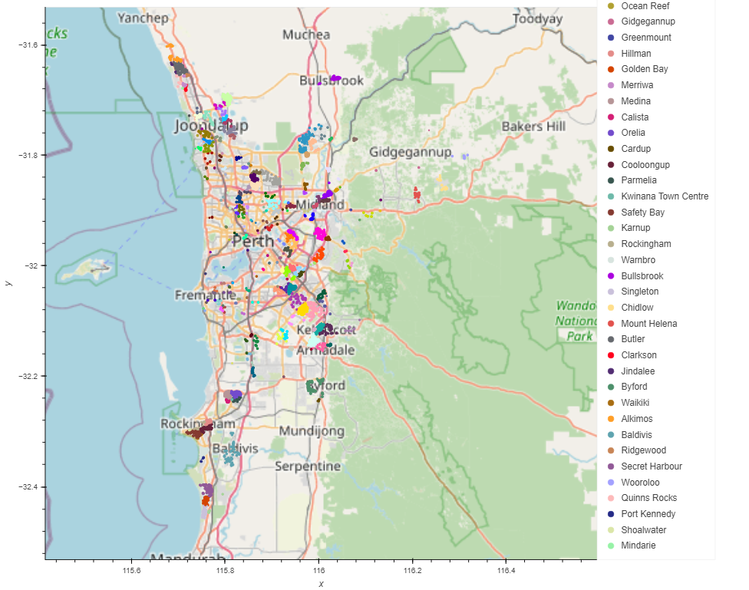
The map illustrates the spatial arrangement and positioning of the least expensive residences, constituting the bottom 20% in value across the entire region.

Slide 15
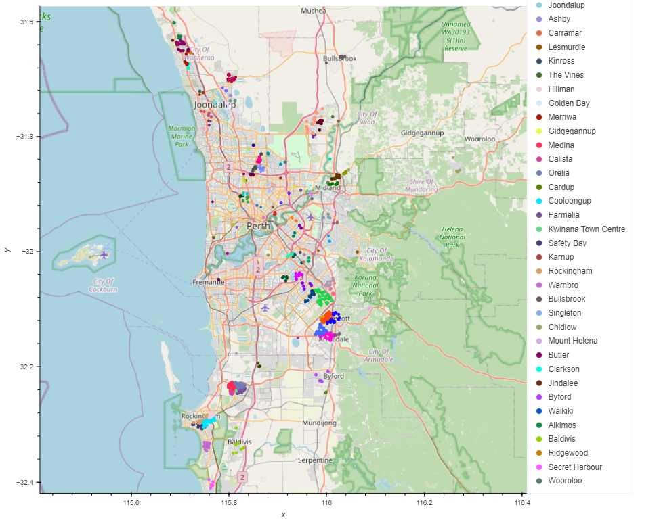
The map illustrates the spatial arrangement and positioning of the least expensive residences, constituting the bottom 5% in value across the entire region.

Slide 16
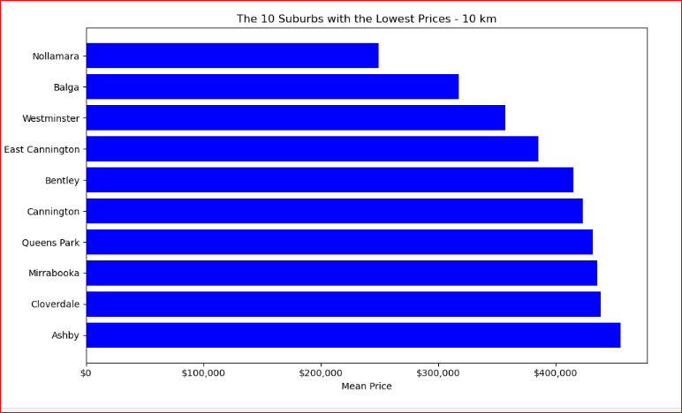
This graph represents the least expensive sales prices in the 10km region from the city centre, this is just based off total sales figures not taking into account bedrooms or bathrooms

Slide 17
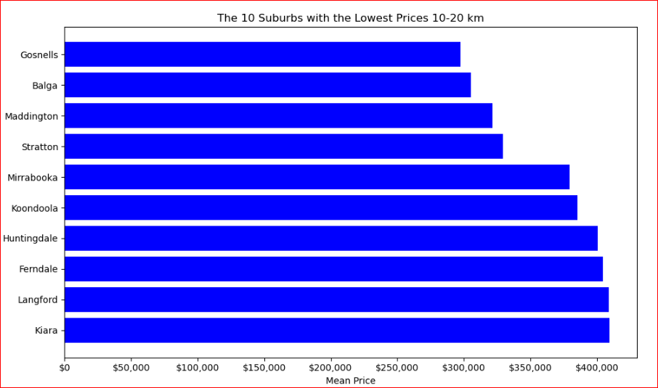
This graph represents the least expensive sales prices in the 10-20km region from the city centre, this is just based off total sales figures not taking into account bedrooms or bathrooms

Slide 18
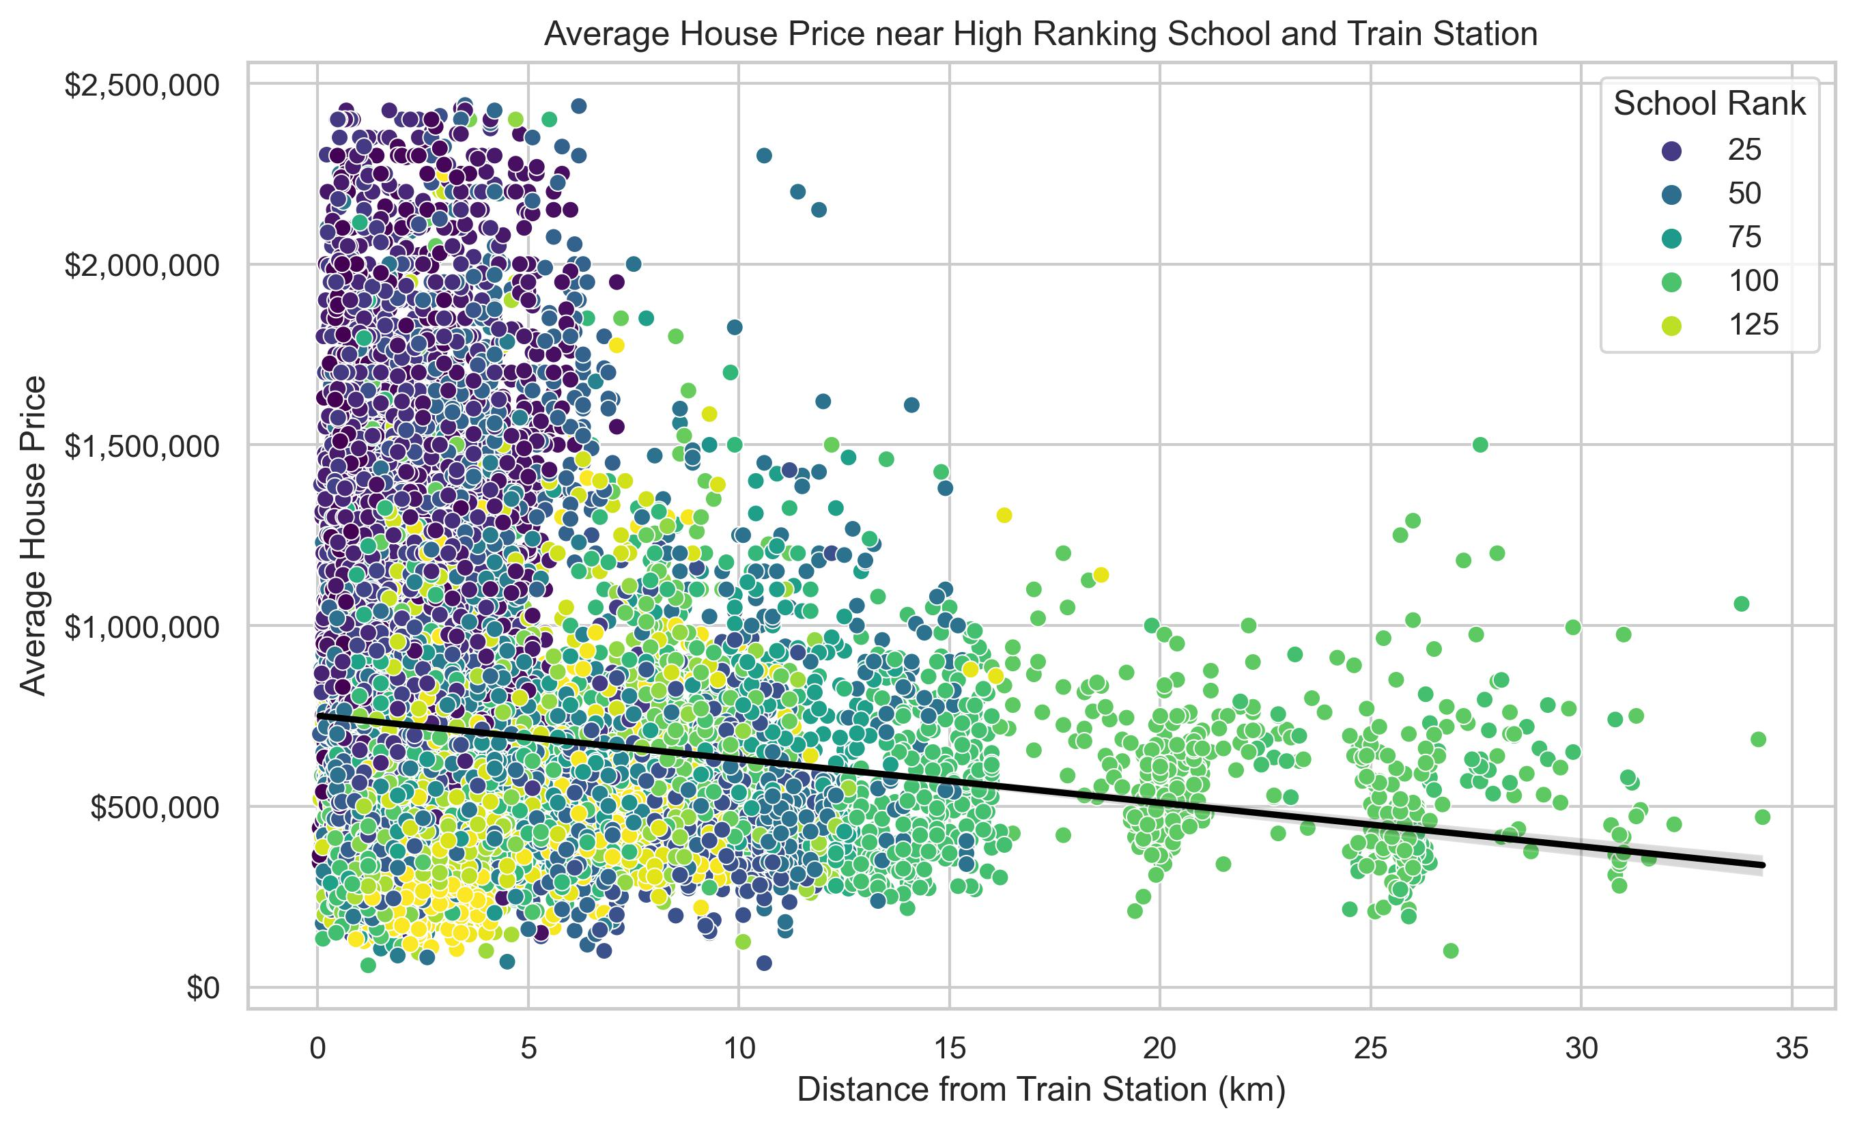
This plot is correlating the previous slides data showing that the school rankings are closely matched to the price of housing and the higher school ranking is also matched with the higher average house price sale and proximity to transportation and the CBD.

Slide 19
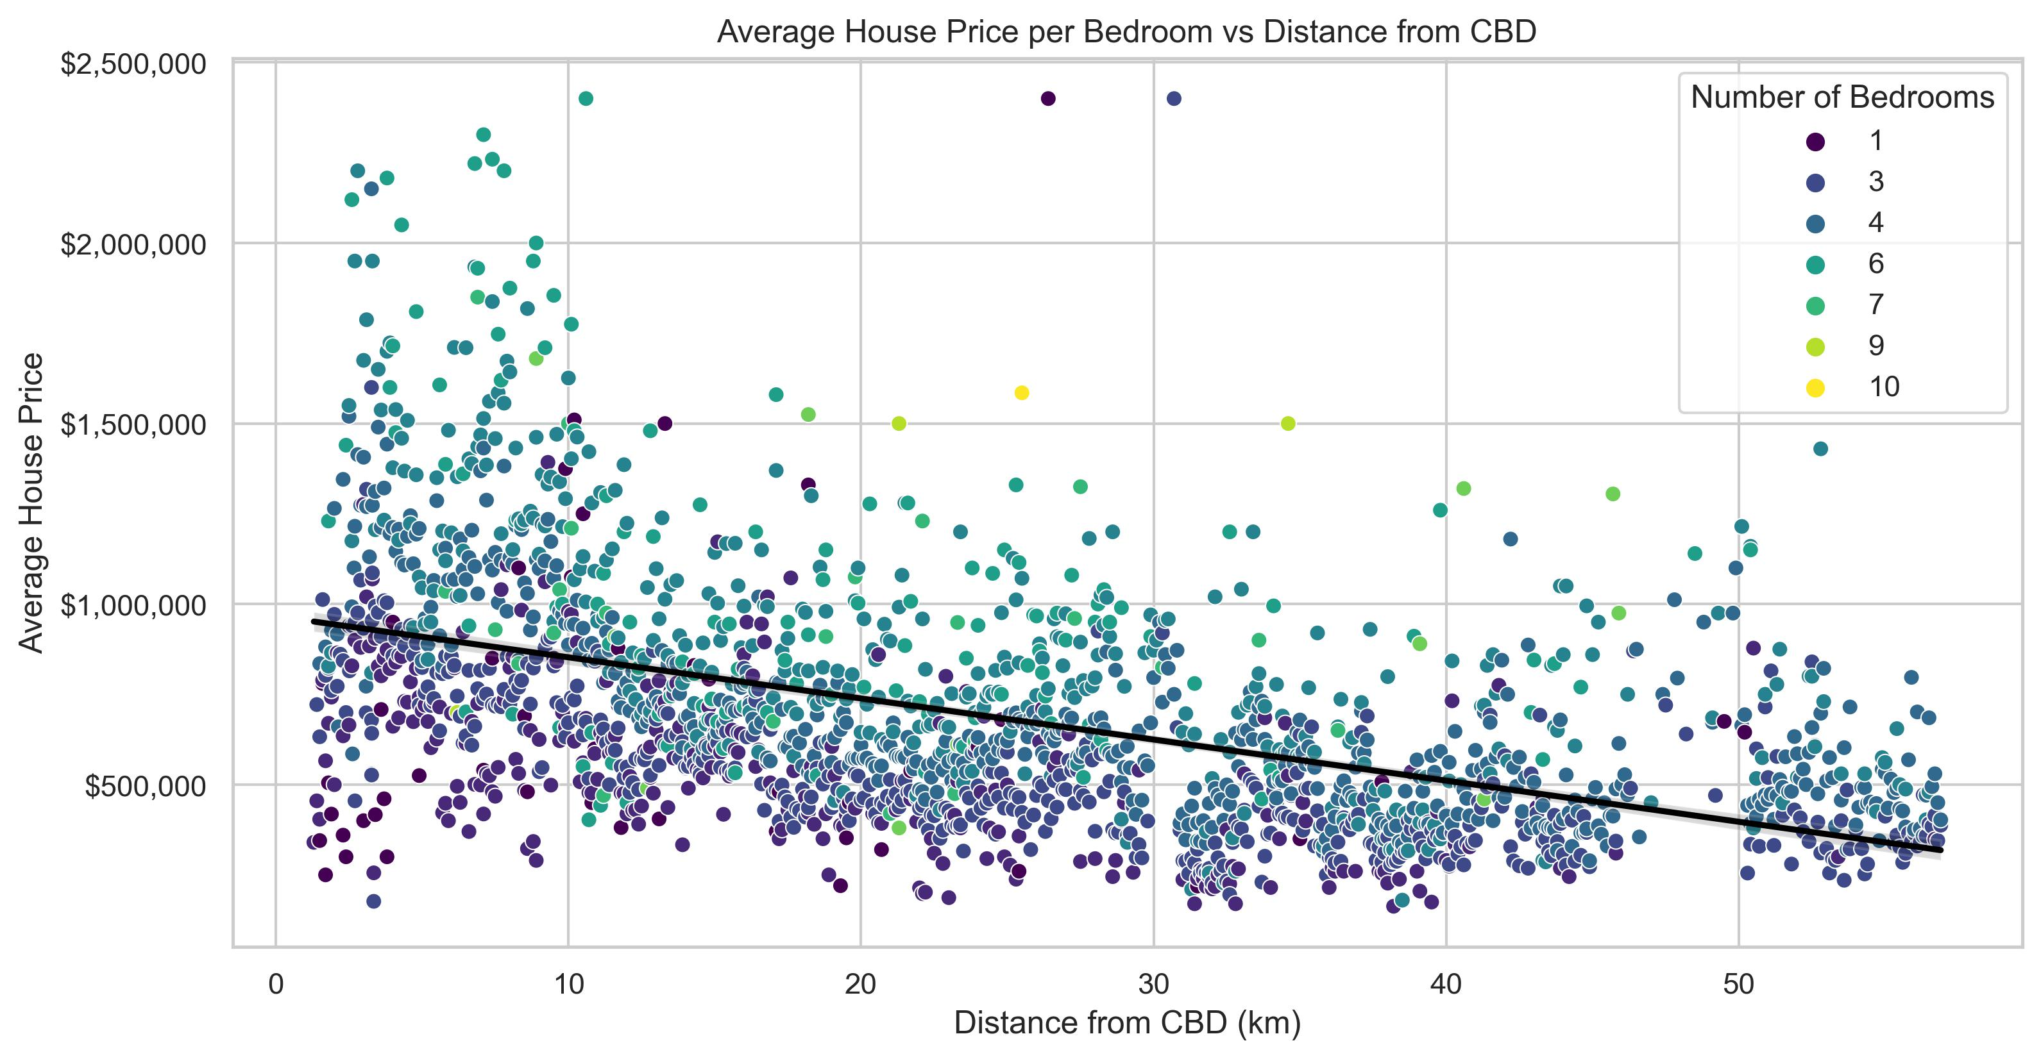
We have found that the average house sold nearer the city has lower bedrooms on average than houses being sold further out from the city.
The housing closer to the city are older constructed houses which typically had less rooms than the newer housing estates being created in the outer suburbs with building caveats on floor area and land sizes.

Slide 20
Conclusions
Does housing sales and the cost of homes in Perth depend on its proximity to the central business district?
Analysis indicates a strong correlation between the cost of homes and their proximity to the central business district in Perth. Homes located closer to the CBD tend to command higher prices. However, it's essential to note that housing prices are not determined by a single variable; they are defined by a combination of property and location characteristics.
Does house characteristics including land area, floor area, number of bedrooms, number of bathrooms, have any influence on the housing prices?
Our analysis confirms that various house characteristics such as floor area, number of bedrooms, number of bathrooms etc. significantly influence housing prices in Perth. These factors are some of the most important determinants of a property's value. These factors play a crucial role in determining the value of a property. Nonetheless, it should be emphasized that housing prices are an outcome of the interplay between these variables.

Slide 21
Land Area
Floor Area
No:of Bedrooms
No:of Bathrooms and Garages
Does property characteristics impact housing prices in Perth?

Slide 22
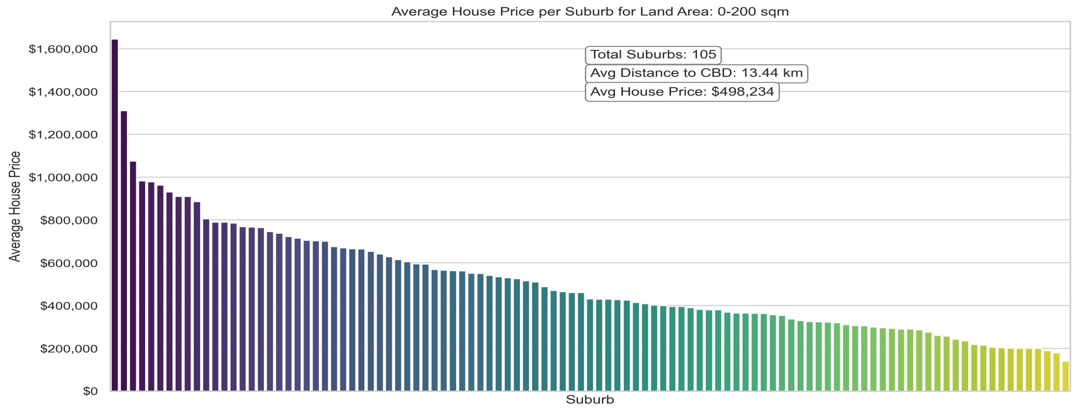
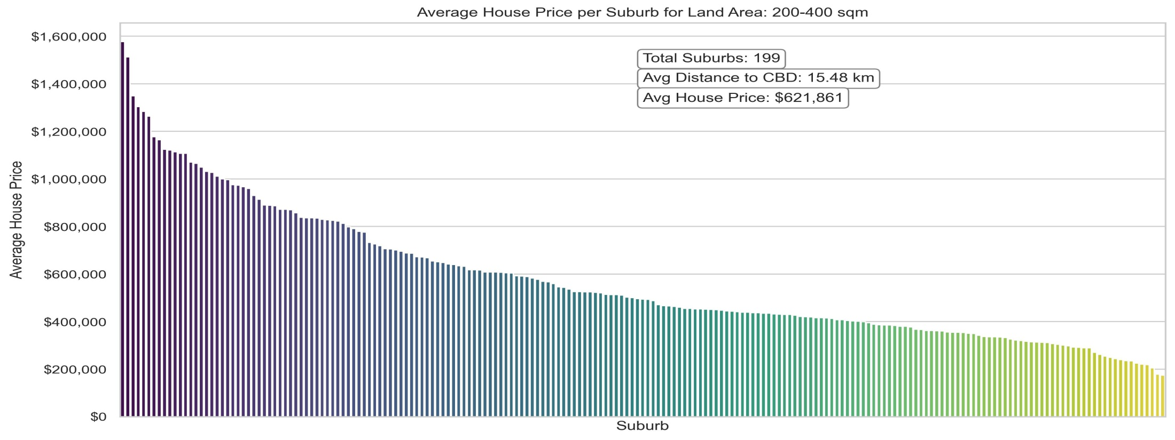

Slide 23
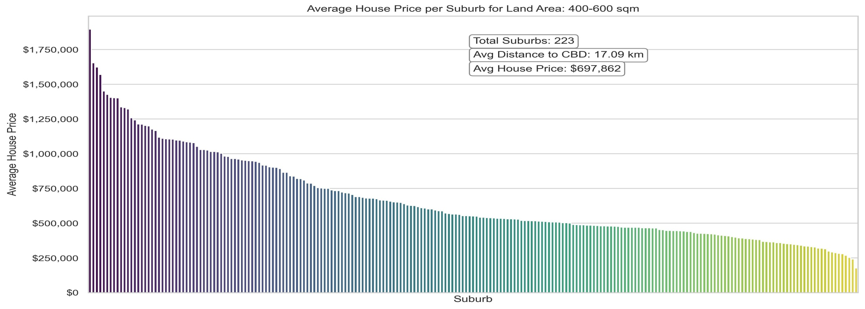
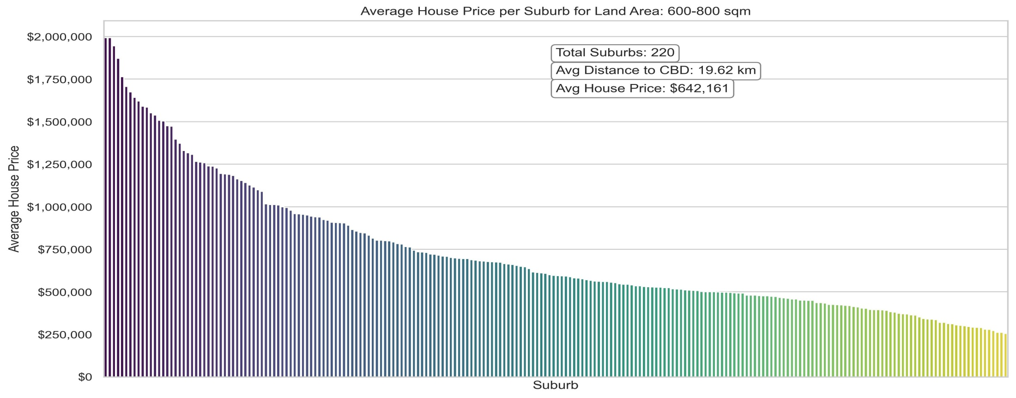

Slide 24
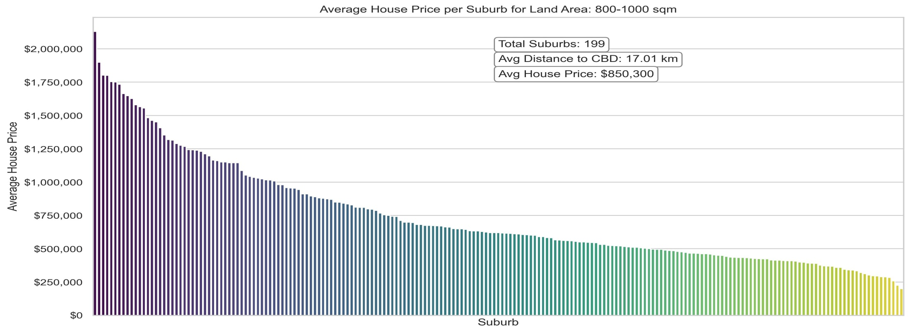
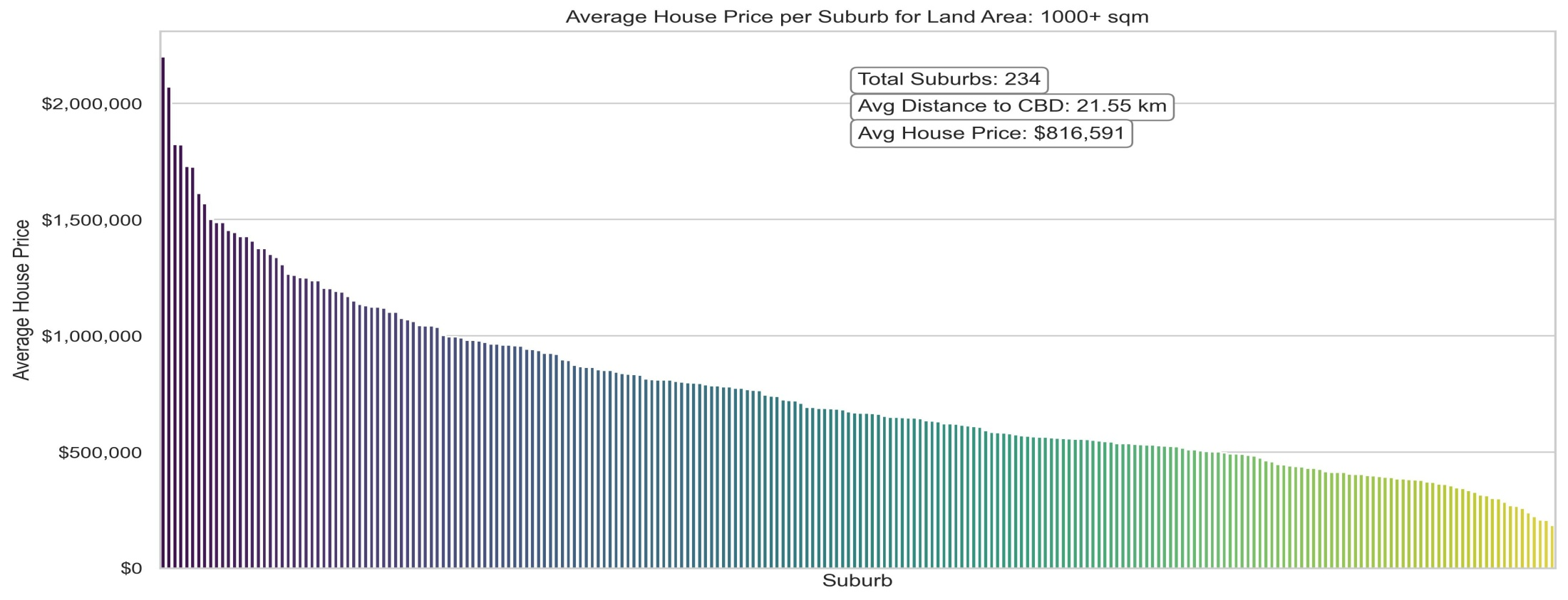

Slide 25
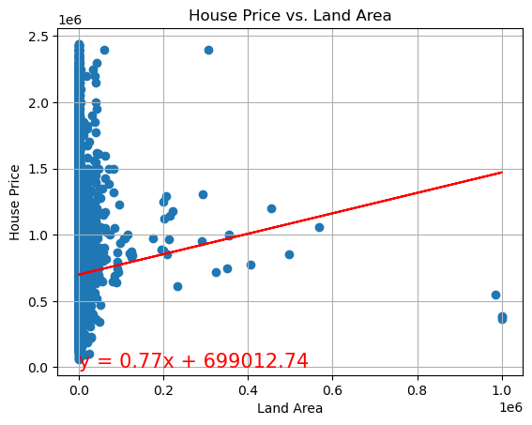
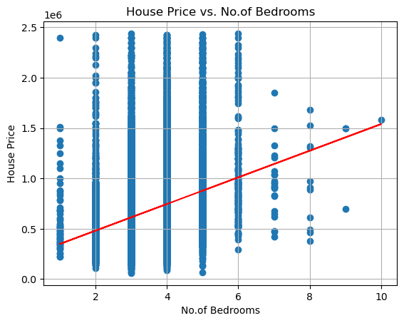
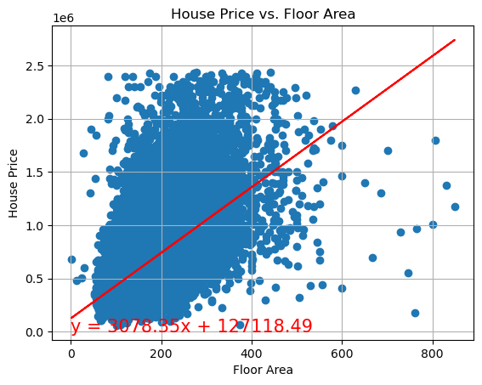
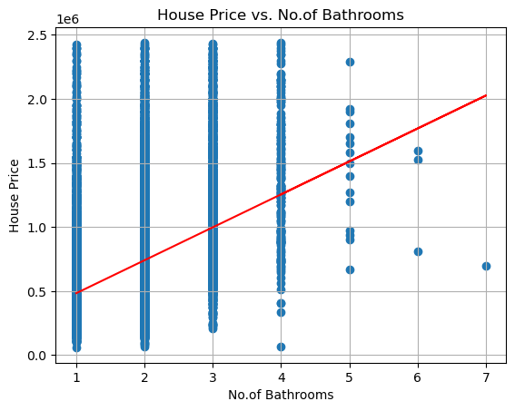
The r-value is: 0.037
The r-value is: 0.258
The r-value is: 0.575
The r-value is: 0.393

Slide 26
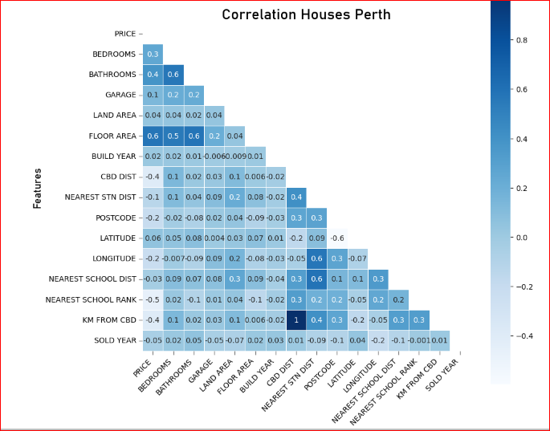
"This graph was taken as a reference from Perth_House_Prices_Analysis_and_Predictions."

Slide 27
Conclusions
Are house costs and the quality of the neighborhood schools correlated? Examine if homes that are close to schools tend to sell for more money.
The analysis establishes a clear correlation between house costs and the quality of neighborhood schools in Perth. Homes situated in proximity to high-quality schools are consistently associated with higher selling prices. Nevertheless, it's important to recognize that housing prices are shaped by a combination of factors, including school quality and property characteristics.
Does the cost of homes in Perth depend on its closeness to public transit (such as railway stations and bus stops)? Investigate if houses close to points of public transportation tend to be more expensive than those further away.
Our analysis reveals a significant relationship between the cost of homes in Perth and their proximity to public transit, including railway stations and bus stops. Properties located near these points of public transportation consistently command higher prices compared to those further away. However, it's crucial to acknowledge that housing prices are the result of a complex interplay between various property and location characteristics.

Slide 28
Conclusions
In summary, the analysis demonstrates that each of these questions holds a true and substantiated relationship in the Perth housing market. While proximity to specific factors like the central business district, house characteristics, school quality, and public transportation does influence prices, it is important to recognize that housing prices are not determined by a single variable. Instead, they are defined by a combination of property and location characteristics that collectively shape the real estate market in Perth.

